Slide 1
CarpetX
2021 Einstein Toolkit Summer School, UIUC
Erik Schnetter, Perimeter Institute
2021-07-27

Slide 2
Outline
What is a driver
TOC
New features (and missing features)
AMR, AMReX, prolongation/restriction
Time integration, no subcycling, refluxing, higher order
Scheduling: interior, boundaries, ghost zones; bins (intr, sync, bnds)
Scheduling: new safety features (reads, writes)
Centering, indexing, loops, GF3D2
Tiling, OpenMP, MPI
GPUs (just a preview), GF3D5, [=], macros
I/O: Silo, openPMD, ADIOS
SIMD: NSIMD
Maybe: Elliptic solvers (AMReX MG, PETSc)

Slide 3
Tom Goodale
Cactus Tutorial
2007-10-17

Slide 4
The Cactus framework
The Driver thorn in Cactus is the “main” function of the simulation:
Scheduling (calls physics functions)
Parallelism (splits grid functions across processes, exchanges ghost zones)
AMR (levels, boxes, interpolation) (AMReX!)
I/O (reading, writing, checkpointing)
…

Slide 5
Outline
Tasks of a driver thorn
Why AMR (Adaptive Mesh Refinement)
CarpetX: New features (and missing features)
New safety features
Vertex and cell centering (conservation laws, div B)
Parallelisation and efficiency (MPI, OpenMP, GPUs)
I/O, SIMD, …

Slide 6
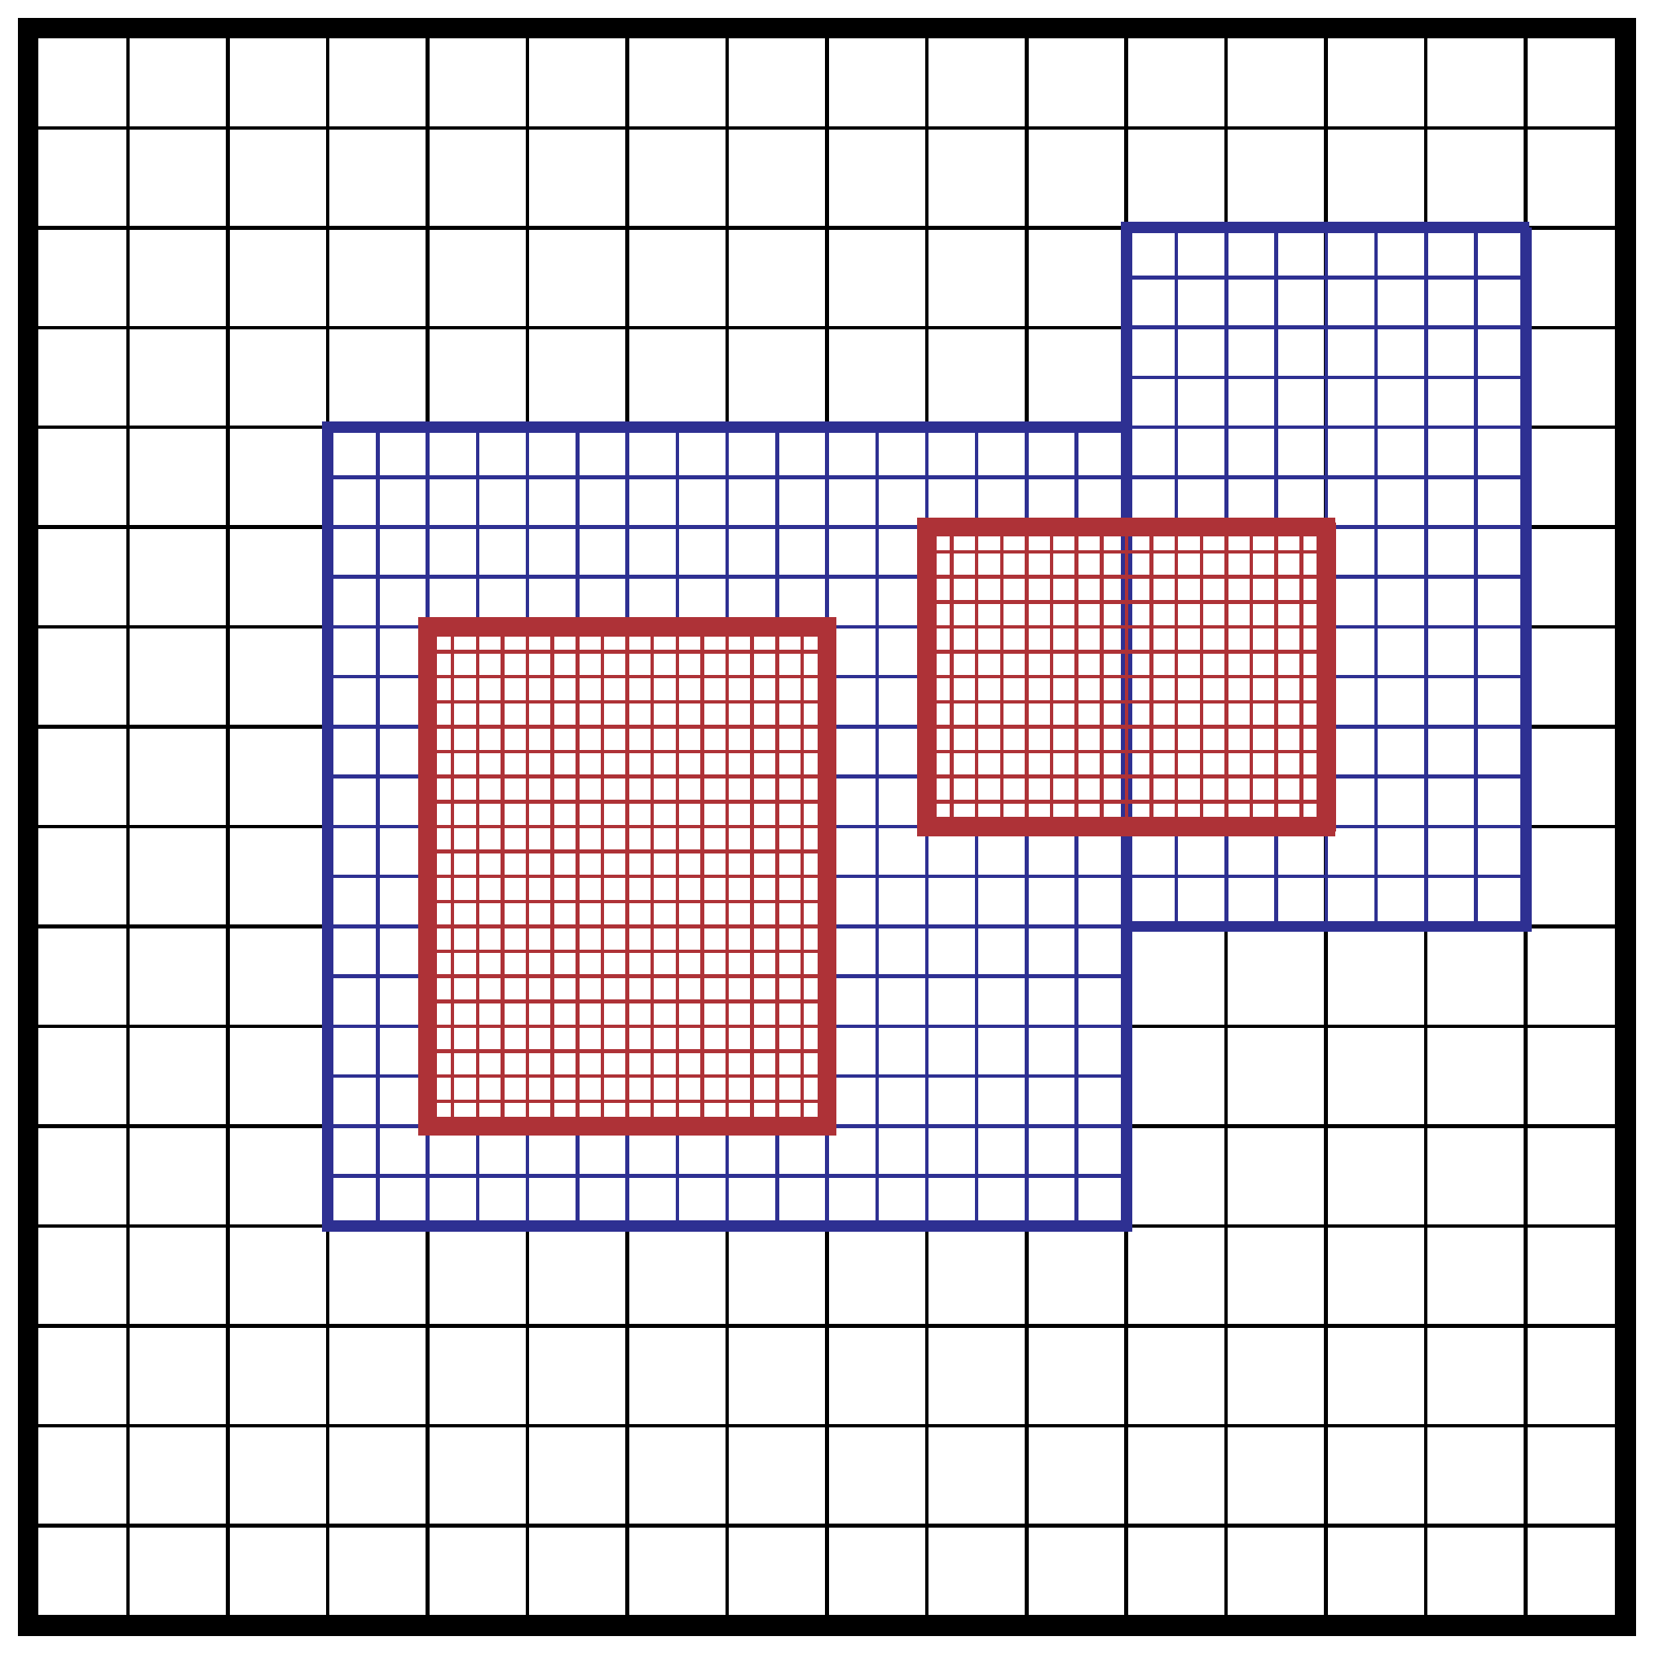
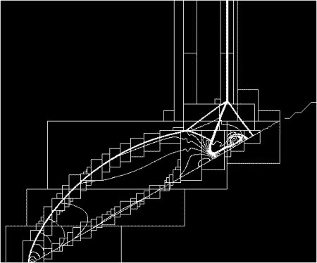
Adaptive Mesh Refinement
Need very high resolution only in small part of domain
Often used for compressible hydrodynamics:
Moving shocks, discontinuities, surfaces
[AMReX documentation]
[Wikipedia: AMR]

Slide 7
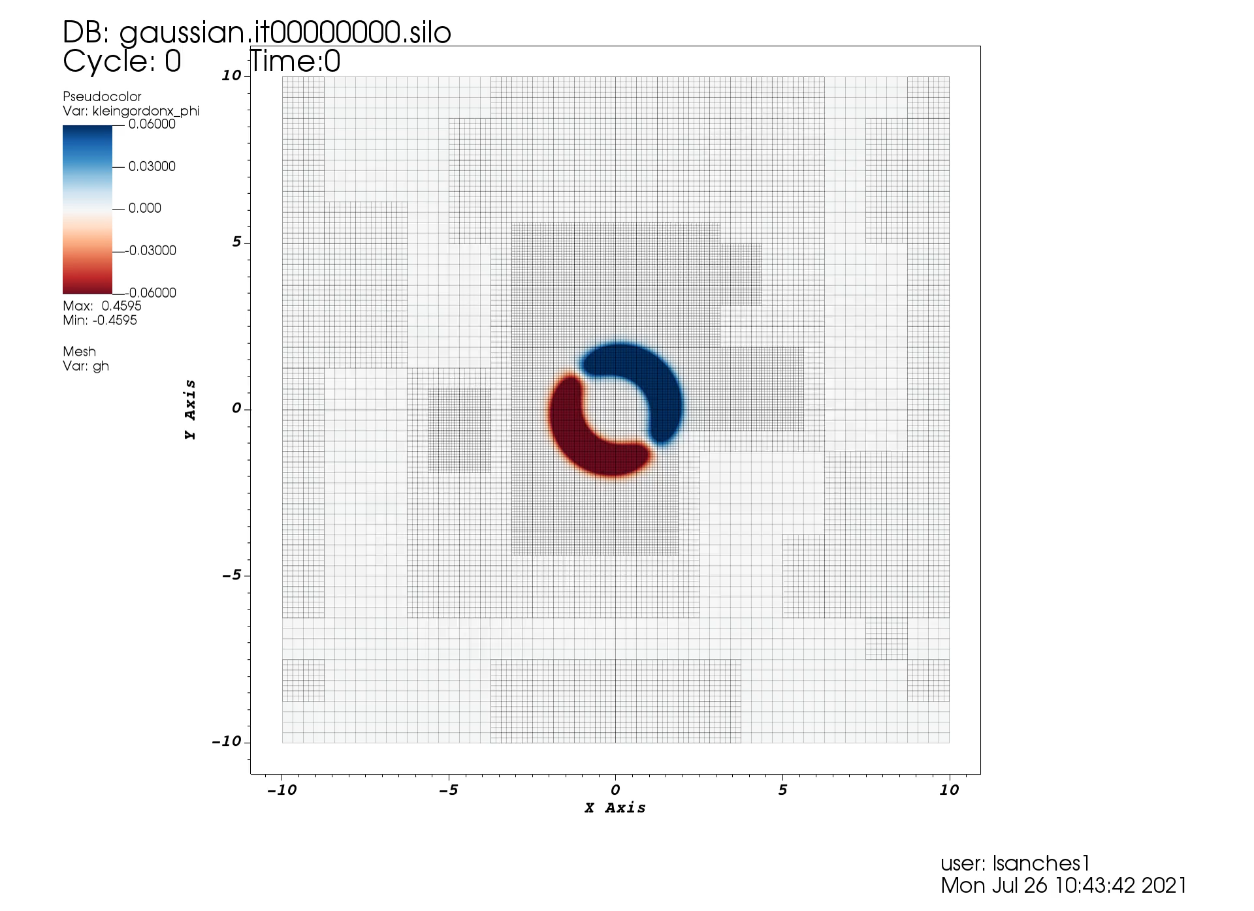
Scalar wave on Minkowski background
Lucas Sanches
Universidade Federal do ABC (Brazil)

Slide 8
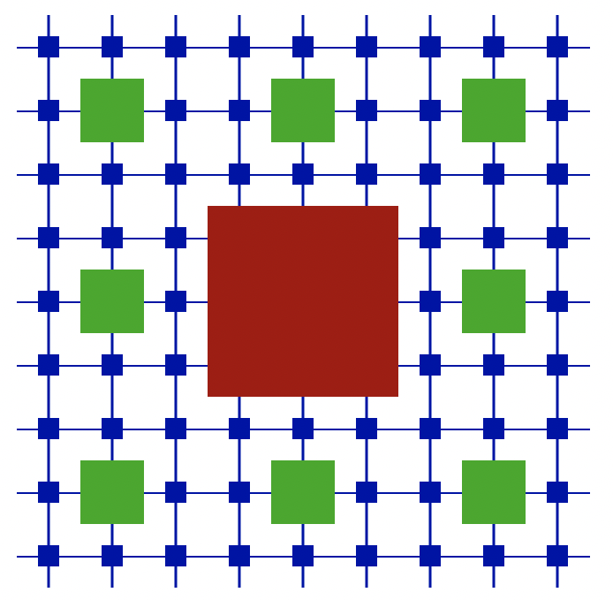
CarpetX – a new mesh refinement driver for numeric relativity
Designed for the Einstein Toolkit
True adaptive mesh refinement based on local error estimate
High-order prolongation/ restriction operators
Vertex/cell/face/edge-centred variables
Refluxing for exact conservation in (M)HD
can currently run a qc0 BBH merger
see presentations by Don Willcox and Erik Schnetter
Uses AMReX
for Exascale scalability
Much improved multi-threading
Much improved I/O speed (ADIOS2, openPMD)
Improved SIMD vectorization
Works with GPUs (CUDA)
[Roland Haas]

Slide 9
CarpetX: Missing features
Not yet implemented:
Global time stepping; no subcycling in time
Rotational symmetry boundaries
GRMHD code
NRPy+ backend
Currently unknown (untested):
Recipes for efficient GPU kernels
MPI scalability (but AMReX is scalable)

Slide 10
New Safety Features

Slide 11
Scheduling
Initial conditions:
CCTK_BASEGRID
Loop:
Initialisation done?
Regrid
CCTK_BASEGRID
CCTK_POSTREGRID
CCTK_INITIAL
CCTK_ POSTINITIAL
CCTK_POSTSTEP
CCTK_ANALYSIS
OutputGH
Evolution:
Evolution done?
Regrid
CCTK_BASEGRID
CCTK_POSTREGRID
CCTK_PRESTEP
CCTK_EVOL
CCTK_POSTSTEP
CCTK_ANALYSIS
OutputGH

Slide 12
Scheduling
BASEGRID:
Set up constant data (e.g. coordinates)
INITIAL, POSTINITIAL:
Initialise state vector (including boundaries)
Define local error for regridding
EVOL:
Evolve state vector (and set boundaries)
POSTSTEP, ANALYSIS:
Calculate ephemeral values (e.g. constraints)
Define local error for regridding
POSTREGRID:
Re-apply boundary conditions to state vector

Slide 13
[Show WaveToyCPU, schedule.ccl]
Discuss:
Using schedule groups
ODESolvers_RHS, ODESolvers_PostStep
READS, WRITES
Sync after boundary conditions (prolongation stencils)

Slide 14
schedule.ccl:
SCHEDULE GROUP WaveToyCPU_RHSGroup IN ODESolvers_RHS
{
} "Calculate RHS"
SCHEDULE WaveToyCPU_RHS IN WaveToyCPU_RHSGroup
{
LANG: C
READS: phi(everywhere) psi(everywhere)
WRITES: phirhs(interior) psirhs(interior)
} "Calculate RHS for the wave equation"
SCHEDULE WaveToyCPU_RHSSync IN WaveToyCPU_RHSGroup AFTER WaveToyCPU_RHS
{
LANG: C
SYNC: rhs
} "Boundary conditions for the RHS of the wave equation"
SCHEDULE WaveToyCPU_RHSBoundaries IN WaveToyCPU_RHSGroup AFTER WaveToyCPU_RHSSync
{
LANG: C
WRITES: phirhs(boundary) psirhs(boundary)
} "Boundary conditions for the RHS of the wave equation"

Slide 15
Declaring Dependencies in the Schedule
Each scheduled function needs to declare which parts of which variables it reads or writes
Regridding, synchronization, prolongation etc. do this implicitly as well
The driver checks consistency, and flags errors
The driver cross-checks these declarations via:
Undefined variables
Const variables
Variables set to nan, and checked for nan
Checksums of parts of variables
Also, there are “informative” error messages

Slide 16
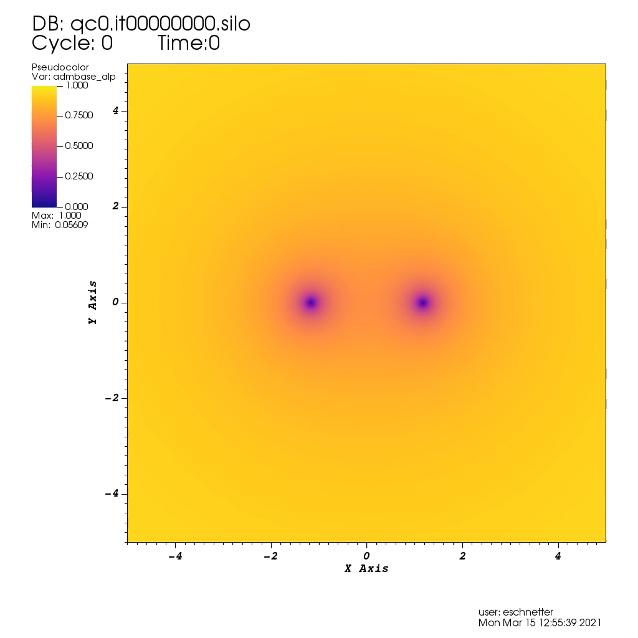
QC-0 (black hole binary)
Large box (+/- 128)
dx[coarse] = 1 dx[fine] = 1/24
4th order everything
~3/4 orbit before merging

Slide 17
Vertex and Cell centering

Slide 18
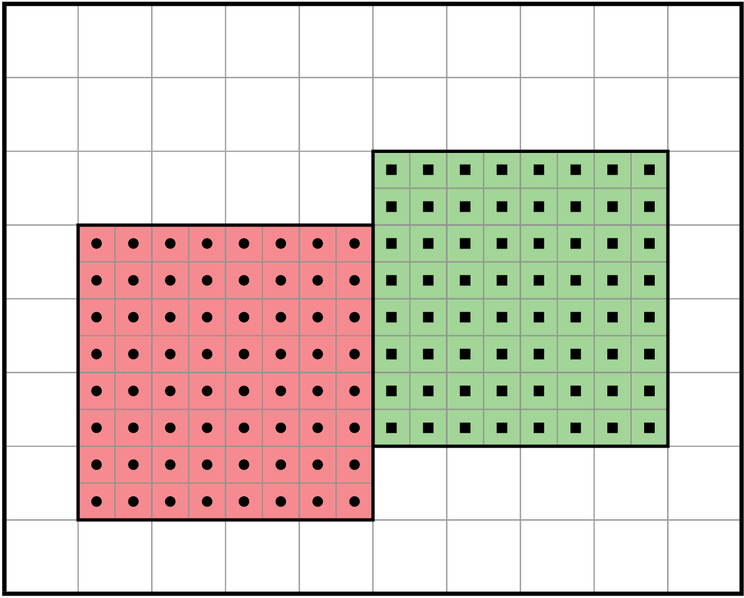

Vertex and Cell centering
”Points” can be located at vertices, edges, faces, and interior of cells (in 3D)
Sample function at vertex
Integrate function along edge
Average function over cell
Allows “baking in” certain properties into discretization scheme
topological invariants
E.g. div B = 0, baryon number conservation
[AMReX]

Slide 19
[Show WaveToyCPU, interface.ccl]
Discuss:
No timelevels
“index” tag
“rhs” tag
“checkpoint” tag

Slide 20
interface.ccl:
CCTK_REAL state TYPE=gf TAGS='index={1 1 1} rhs="rhs"'
{
phi psi
} "Scalar potential for wave equation"
CCTK_REAL rhs TYPE=gf TAGS='index={1 1 1} checkpoint="no"'
{
phirhs psirhs
} "RHS for scalar potential for wave equation"
CCTK_REAL energy TYPE=gf TAGS='index={1 1 1} checkpoint="no"'
{
eps
} "Energy density for wave equation"
CCTK_REAL err TYPE=gf TAGS='index={1 1 1} checkpoint="no"'
{
phierr psierr
} "Error of wave equation solution"

Slide 21
Parallelisation and Efficiency

Slide 22
Parallelisation and Efficiency
Shared memory: Many cores can access the same memory
Need to split loops, but can use same array
Easy to use, but only for small problems (workstation)
Multi-threading (OpenMP)
Distributed memory: No common memory
Need to split data structures as well as loops
Difficult but necessary (HPC systems)
Separate processes (MPI)
Accelerators (“GPUs”):
Each accelerator is a shared memory system
HPC systems have many accelerators, i.e. distributed memory

Slide 23
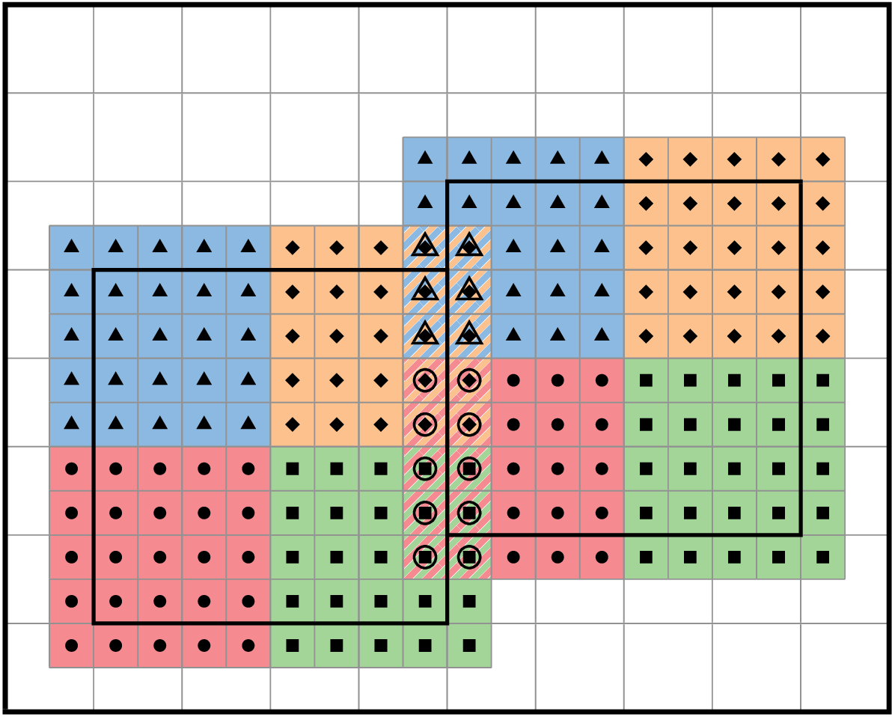
Ghost Zones
Tiling for shared memory
Each block has 4 coloured tiles
Ghost zones for distributed memory
Each block is surrounded by a layer of extra points
Ghost zones need to be kept consistent (synchronization)
AMR:
Prolongation (interpolation from coarse to finer level ghosts)
Restriction (from fine to coarser level where they overlap)

Slide 24
Scalar wave on Minkowski background
Lucas Sanches
Universidade Federal do ABC (Brazil)

Slide 25
Miscellaneous

Slide 26
I/O
Need standardized file formats and standardized metadata
For post-processing, visualization, initial data exchange, etc.
(Low-level) file formats can store blocks of data
HDF5, ASDF, ADIOS2, …
(High-level) metadata describes how blocks need to be assembled
Silo, openPMD, ???
Efficient parallel I/O is difficult
ADIOS2, with openPMD metadata

Slide 27
SIMD (vectorization for CPUs)
Modern CPUs can execute up to 8 operations simultaneously
(“threads” in CUDA, CPU threads are “blocks” in CUDA)
Compilers are not good at generating SIMD code from scalar kernels

